Slide 1
Dire Wolf Software TNC
John Langner, WB2OSZ
ATGP, December 14, 2021

Slide 2
Topics
History: Packet Radio. What is a TNC?
Main Theme: Replace old hardware TNC with only software.
Building a better demodulator.
Notes:
If you do a web search for an introduction to APRS or Packet Radio, you will find a lot of information.
Most of it is outdated.
Most of the “how to get started” guides tell you to spend a couple hundred $$$ on a device from the 1980s and use software that was obsolete long ago. The start up cost barrier scares most people away from trying something new. Others might spend their money foolishly before they know about what is available and the trade offs.
Tonight I will be talking a little bit about the history of the Packet Radio TNC and why it’s no longer needed in many cases. You can do the same thing better and cheaper by using free open source software.
Ham radio transceivers are designed for using voice, not modems to send data. FM radios distort the signals, making it harder for the modems to perform well. I will discuss how the signals are intentionally distorted and one technique to compensate for this distortion.

Slide 3
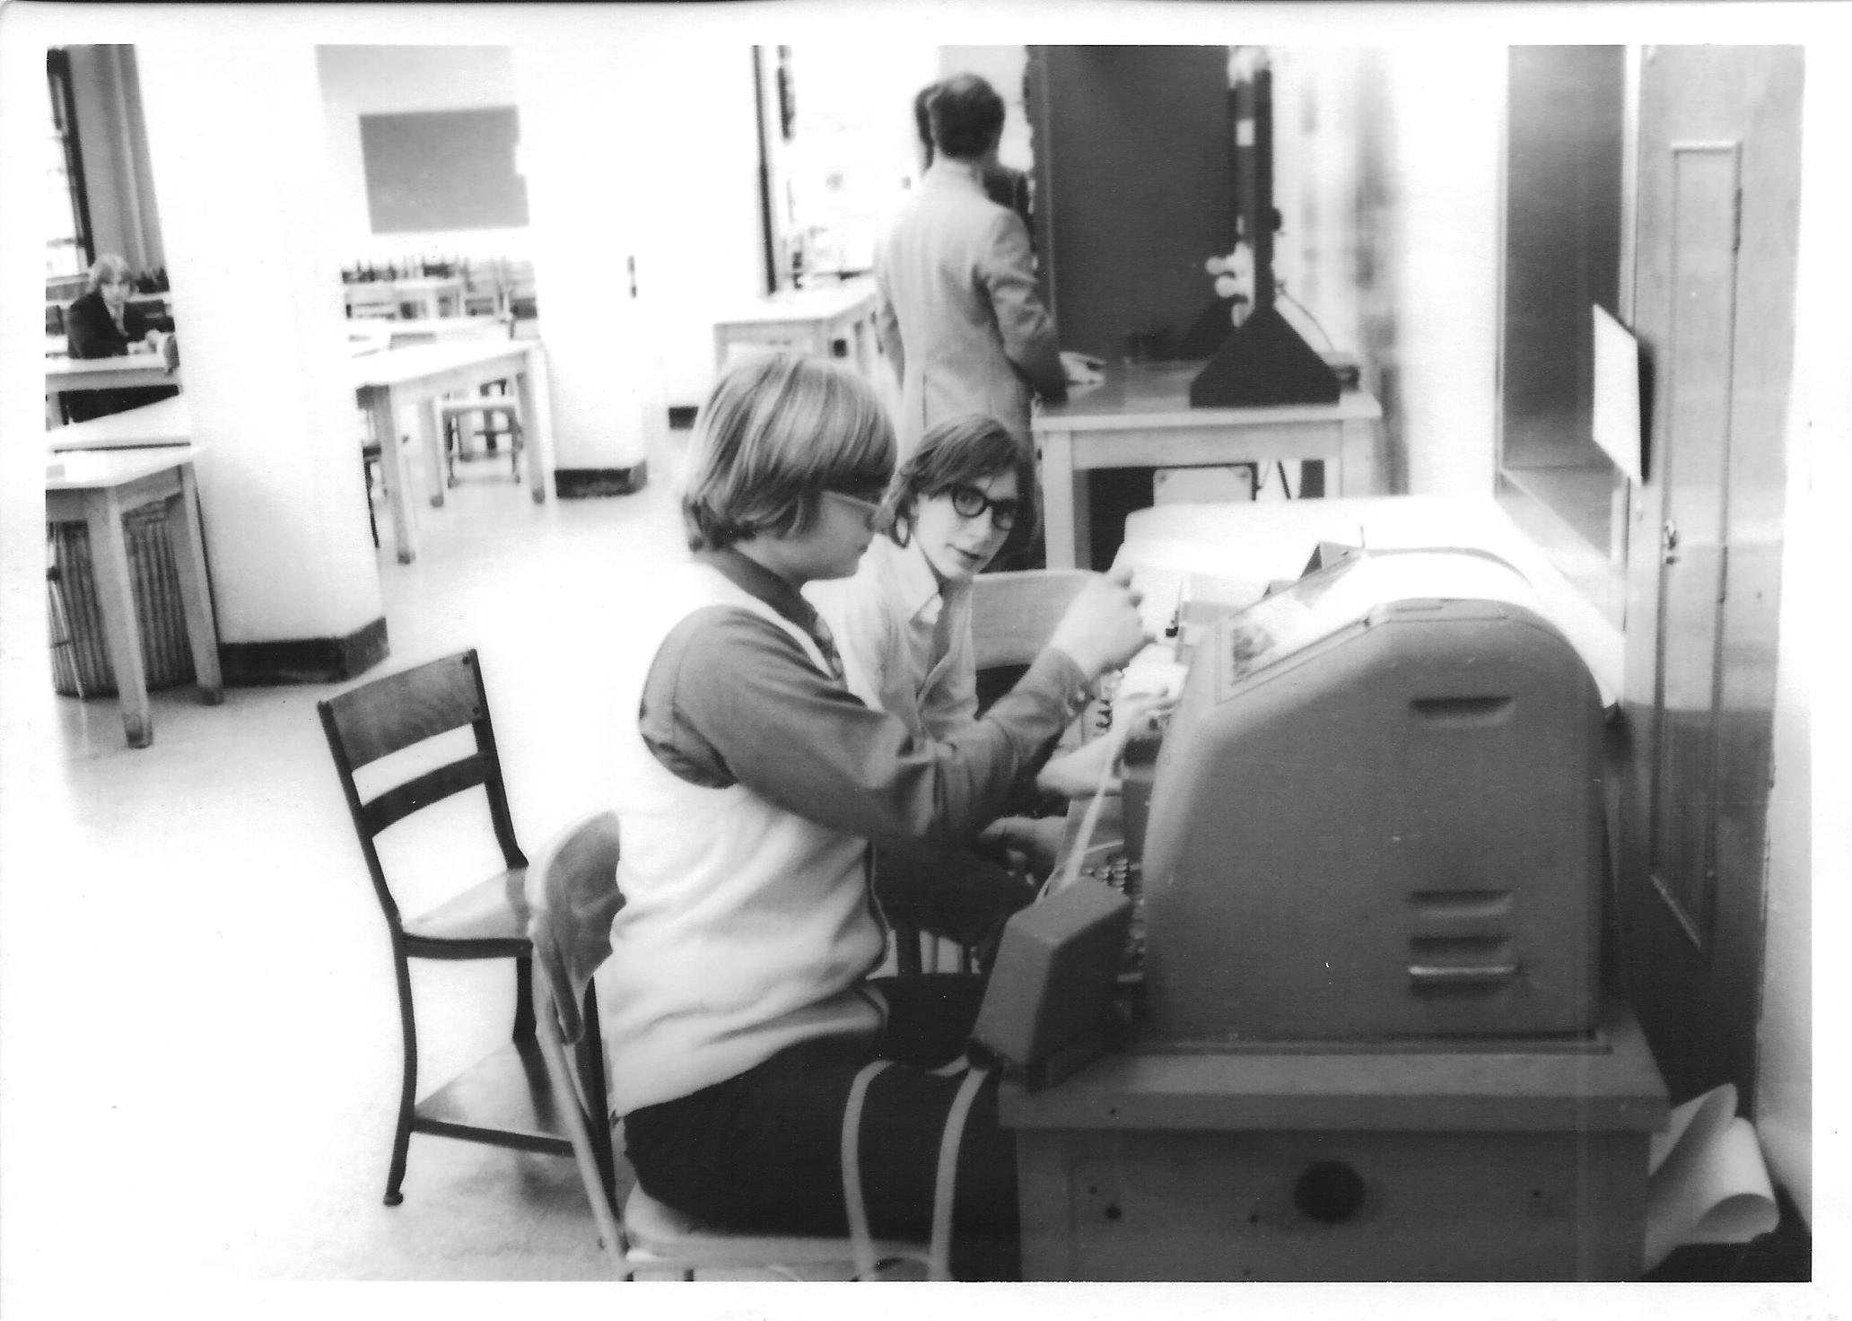
Notes:
Back before personal computers, his is how we sent text over ham radio.
Ask audience: How many of you have used one of these?
(??? and WN2BUB.)

Slide 4
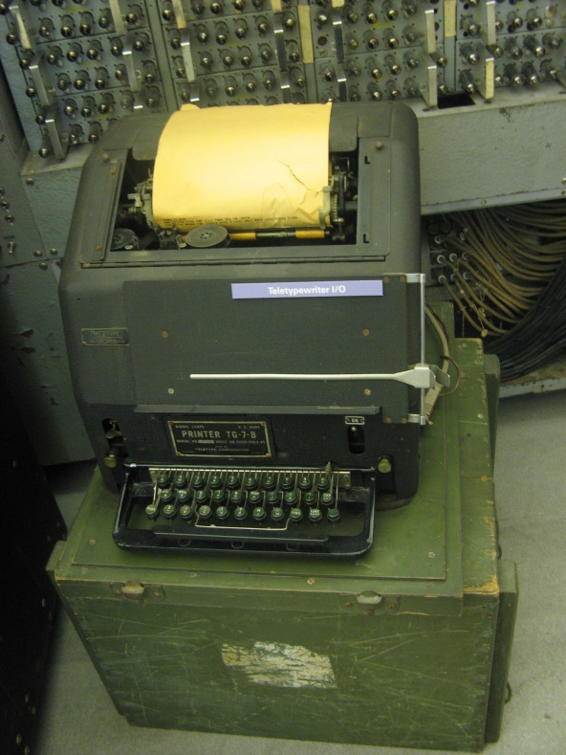
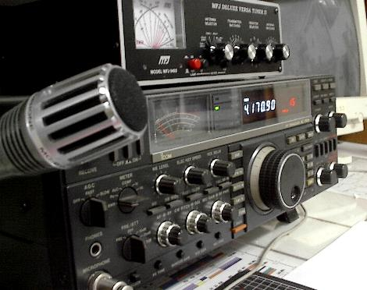
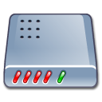
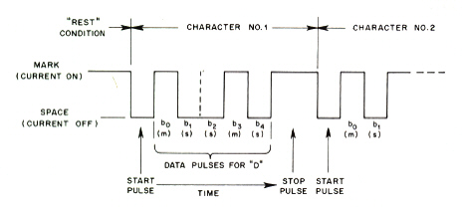
Radio + Teletype = RTTY
Simple
Modem
Audio & PTT
Modem was called a “terminal unit”.
170 Hz AFSK
AFSK → SSB → RF FSK
Notes:
Teletype machines were first developed in the 1930’s. As soon as they became available on the surplus market, hams began to use them on the air.
It wasn’t difficult to get started. You just needed to add a simple modem which was called a “terminal unit.”
It was not an efficient way to send text. First you would turn on the transmitter and it would sit there transmitting a 100% duty cycle carrier. Characters were sent one at a time as the keys were pressed. There was no error detection so you would often see garbled messages.
It used a 5 bit code, commonly known as “baudot.” This allows only 32 different combinations, not enough for all letters and digits. Some of the codes were for control functions like carriage return, line feed, or bell. 26 of the codes were for letters. A “shift” control code was used to get digits or special characters instead of letters. Very often noise would get interpreted as a shift code and would see a bunch of digits and other characters where there should be letters.

Slide 5
Packet Radio - 1978
Radical new concept.
Montreal Amateur Radio Club.
Vancouver Area Digital Communications Group.
Each transmission was a short burst (“packet” or “frame”) containing:
Notes:
In the late 1970s, Canadian hams began experimenting with a much different method of sending data over the air.
Rather than keeping the transmitter on and sending one character at a time, information was sent in a short package (or “packet”).
Each transmission contained: (explain these …)
Destination address.
Source address. (e.g. ham callsign)
Information part.
Error checking (FCS, CRC).
[[ Fact check: This is the AX.25 format, a little different than what was used initially. Close enough for our purposes here. The point here is that information was sent in packets, with error checking, rather than one character at a time. ]]

Slide 6
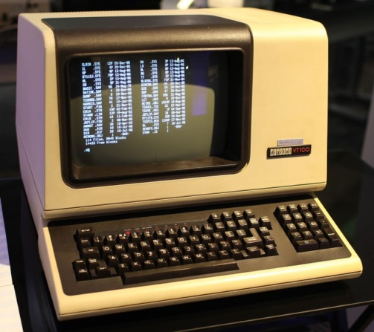
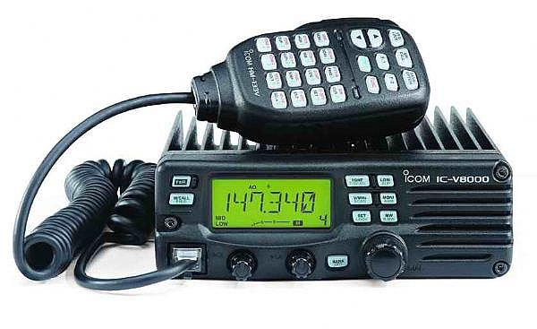
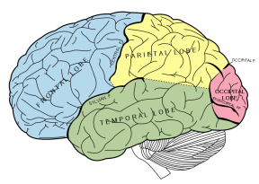
Packet Radio
Modem &
packet protocol
RS-232
Audio & PTT
Terminal Node Controller (TNC).
Modem + brains.
Notes:
With RTTY the keyboard is connected directly to the modem and characters are sent as you type.
For Packet Radio, some brains are added between the terminal and modem to implement the protocol used over the air.
This device is called a Terminal Node Controller (TNC).
The operator could take a while to compose a message. When the message is complete, it is sent in a short burst known as a frame or a packet.

Slide 7
Advantages of Packet Radio
Short bursts.
Addresses.
Shared channel.
Error detection.
ACK & retry – for “connected” mode.
Repeaters.
“Transparent” for “binary” data.
Notes:
This new approach offers many advantages.
Rather than tying up a radio channel with one person typing a character at a time, a message could be sent in a short burst.
Each packet contains information about where it came from and where it should be going.
This allows many people to share one frequency.
Error detection provided confidence that the data was not corrupted.
When connected to another station, the TNC would send acknowledgements when data was received correctly and perform retries when it doesn’t get thru the first time.
Data was not limited to printable characters. You can send any byte stream such as JPEG images.

Slide 8
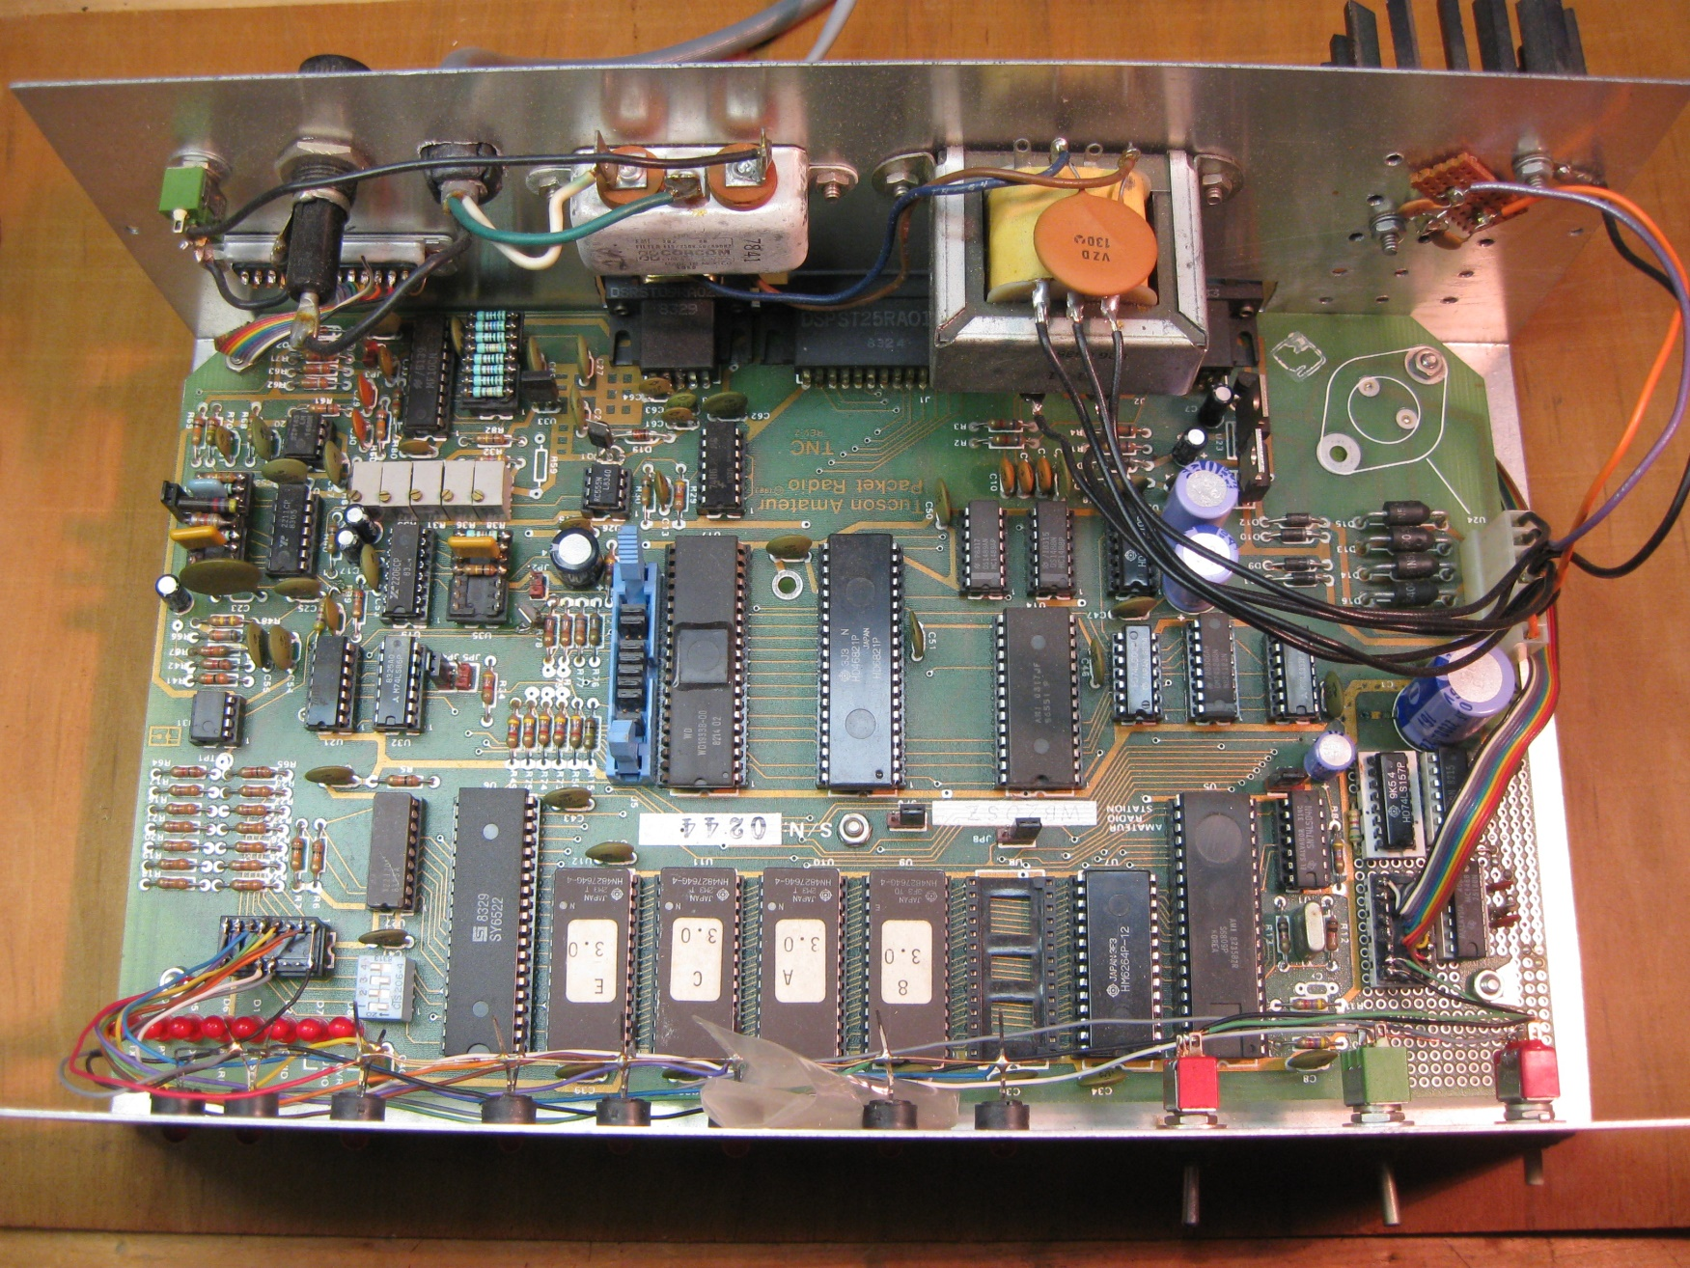
TAPR TNC-1 kit - 1983
Notes:
American ham radio operators had a disadvantage. The FCC did not allow the ASCII code to be used over ham radio until 1980. Special permission was required to perform the same type of experimentation as the Canadians.
The Vancover Amateur Digital Communications Group made their design available as a bare printed circuit board. It was necessary to gather up all the other parts. It didn’t even include the modem. Building was not convenient so it did not become popular.
In 1983, Tucson Amateur Packet Radio (pronounced tapper) introduced their TNC-1 kit which made it a lot easier.
- All parts including modem and power supply.
- Documentation about 2 inches thick. Own binder.
- $350 Did not include case.
This was later available as the Heathkit HD-4040.
They threw a lot of hardware at the problem. About 27 integrated circuits.
The TNC-2 came along a couple years later. It was smaller and cheaper. MFJ and others produced products based on this design. For a while , everyone was churning out new TNC products.

Slide 9
Dumb Terminal to Human Interface
K1OJH>ALL,W0RLI*:NEPRA meeting tonight at 7:00
cmd> c k7ve
*** CONNECTED to K7VE
I will bring the cable that you need tonight.
Great! See you there.
(ctrl-C)
cmd> d
*** DISCONNECTED from K7VE
Not good for computer control.
Notes:
The user interface was designed for a person sitting at a dumb terminal talking to another person.
Soon people got bored with talking person to person and started building applications such as bulletin board systems. This interface not well suited for communication with a computer application.
Characters going TO the TNC:
- Commands.
- Data for another connected station.
Characters coming FROM the TNC:
- Monitoring of activity.
- Echoing of what was typed.
- Response to commands.
- Text from other connected station.
- Status messages – vendor specific.

Slide 10


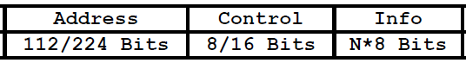
K.I.S.S. Protocol - 1986
Very simple (KISS) TNC
RS-232
Smaller brain needed for TNC.
Transmit: TNC adds CRC and HDLC flags.
Receive: TNC checks for correct CRC and removes it.
Notes:
This lead to the “KISS” protocol, in 1986, which was better suited for talking to a computer application. This was meant only as a temporary stop gap measure until something better could be devised. We are still using it more than 35 years later.
Most of the protocol handling is moved to the computer. The TNC simply adds wraps the packet contents in HDLC.
Full featured TNCs have a KISS mode which allows an application to bypass the usual user interface and get closer to what actually goes over the radio.
There are also low end TNCs that only handle the KISS protocol.
The protocol is too simple and doesn’t provide any information about the TNC status or what is happening on the radio channel. For example an application might send a dozen packets to be transmitted. There is no standard way for the application to know whether they have been transmitted, are still waiting on a busy channel, or whether some of them were discarded because the TNC ran out of memory. Different people started filling in the gaps with different incompatible schemes.

Slide 11
APRS – Data Types
“APRS is not a vehicle tracking system. …”
Positions (usually transmitting station.)
Objects (usually on behalf of other entity.)
Weather Reports.
Telemetry.
“Messages” to an individual or bulletins to groups.
Queries and Responses.
APRS of Things. (like Internet of Things)
Notes:
Packet Radio was hot stuff for a while into the early 1990s. Everyone was churning out new TNC products. After the Internet became generally available we lost interest in packet radio bulletin board systems.
So what do we do with all those TNCs no longer being used? WB4APR came up with a scheme called APRS, for Automatic Packet Reporting System. He liked to refer to it something like a tactical real time information source for local situational awareness.
This is not a general Introduction to APRS but I would like to emphasize it is far more tracking cars or a house saying, “I’m still where I was 2 minutes ago. I’m still where I was 2 minutes ago. I’m still where I was 2 minutes ago.”
APRS has a lot of potential and most of us are using only a small part of it.
If I dive into this we will be here for hours. Let’s get back to our main topic of replacing the traditional TNC with just software.

Slide 12
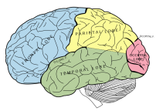
Packet / APRS – late 20th Century
Hardware TNC from 1980’s
RS-232
Notes:
15 or 20 years ago this was the accepted way of doing things.
You would run some sort of application on your computer and spend $200 for a special box between your computer and radio.

Slide 13
TNC replaced by software
Audio & PTT
Cheaper.
Better Results.
Notes:
If you are already using a computer, there is no need for a separate TNC.
The TNC functionality can be handled by software running on the PC.
Cheaper, better results. Easy upgrades – software update instead of buying new EPROMs.
Everyone does this for modes like Fldigi and FT-8 but some people seem to have a mental block about doing the same for packet radio which is simpler.

Slide 14
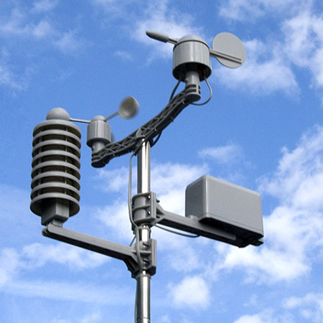
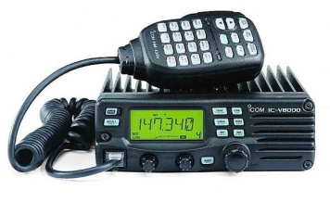
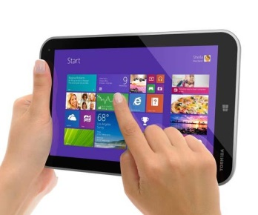

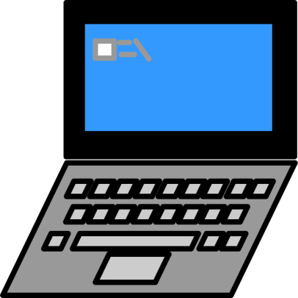
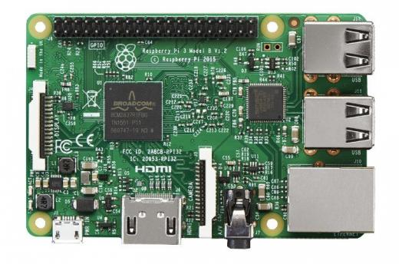


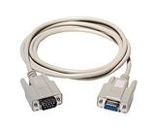
More Flexibility
APRSDroid,
APRSISCE,
YAAC,
Xastir, UISS,
APRS-TW,
WinLink Express, Outpost PM, etc.
Raspberry Pi
TNC software.
APRS-IS
Notes:
The software TNC approach is very flexible. You are no longer constrained by that serial port cable and a single radio interface.
You could have a software TNC running on a Raspberry Pi in your “shack” near your radios. It can run digital repeaters on multiple frequencies at the same time. It can be a router between different radio networks with user defined filters to limit what is allowed through.
It can also be connected to a weather station, and send telemetry data.
At the same time, it can be an Internet Gateway, connecting your local radio network to others around the world over the Internet.
Multiple applications can be using it in place of a traditional TNC at the same time.
On a nice summer day, you could be relaxing next to the swimming pool with your laptop or tablet instead of being in your basement. The application you are running connects to the TNC software using WiFi or BlueTooth.

Slide 15
What is Dire Wolf ?
Free Open source software replacement for the traditional TNC.
Windows, 32 or 64 bit.
Linux - x86, x86_64 PC, ARM, Raspberry Pi.
Mac OSX, BSD.
GPS Tracker.
Digipeater.
Internet Gateway (IGate).
APRStt gateway.
Virtual TNC for applications such as APRSIS32,
YAAC, Xastir, SARTrack, PinPoint, APRS, APRS-TW,
UISS, Linux AX25, WinLink Express (RMS Express), Outpost PM, Linpac, and many others.
Notes:
Adlib …
Runs on these operating systems…
Provides these functions without additional applications…
Dire Wolf can be used with any application designed for use with an old fashioned TNC.
APRSIS32, YAAC, and Xastir are popular APRS applications which display icons on a map.
SARTrack looks similar but was specifically designed for Search and Rescue.
(Note: It’s time to stop mentioning UI-View32. The author became a silent key in 2004 and left instructions to destroy the source code. It is frozen at that point and I’ve seen mention that it has problems with anything newer than Windows XP.)
APRS-TW is specifically for watching telemetry. You can do things such as setting alarms when values cross thresholds.
UISS is for contacting the International Space Station.
Linux AX25 is a collection of applications which allow you to run TCP/IP over ham radio.
WinLink Express (formerly RMS Express) and Outpost PM are messaging applications used by emergency communications groups.
Linpac is short for Linux Packet.

Slide 16
Where did the name come from?
Decoded
Information from
Radio
Emissions for
Windows
Or
Linux
Fans
Notes:
You are probably wondering where the name came from.
Something like “soft TNC” would too generic and boring.
I wanted something distinctive and memorable.
I started juggling words that describe it and came up with this.

Slide 17
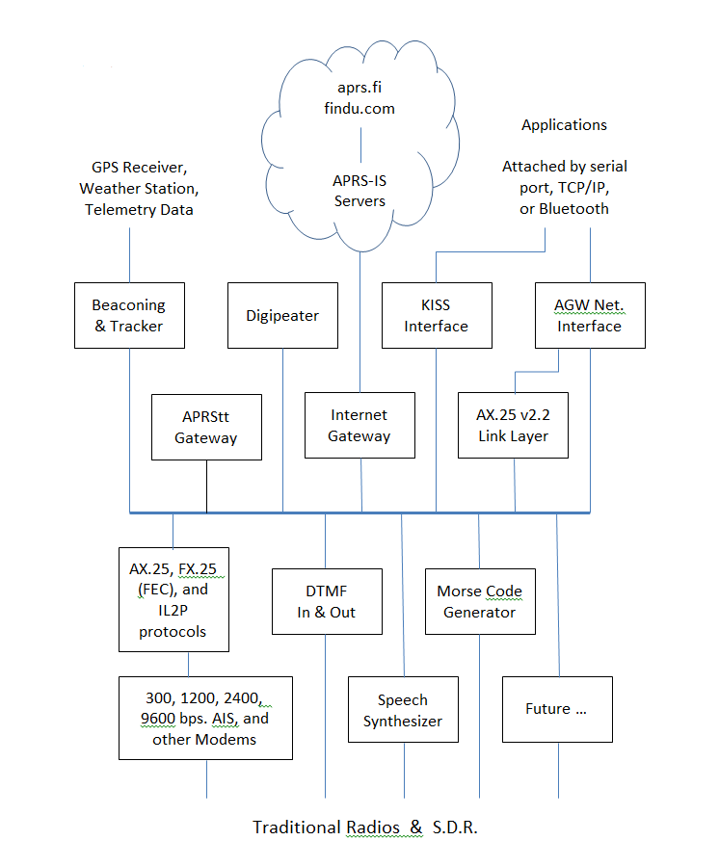
Notes:
Here is a block diagram of the Dire Wolf functionality.
Don’t try to read all the little boxes. We will be visiting some of them separately.
The key point to notice here is the layering. We start with the radios at the bottom.
Above that are modems and other ways of sending information over the radio.
Above that are different ways to produce or consume data going over the radio.
Finally along the top, we have other external interfaces such as GPS receivers, weather stations, the Internet, and other local applications.

Slide 18
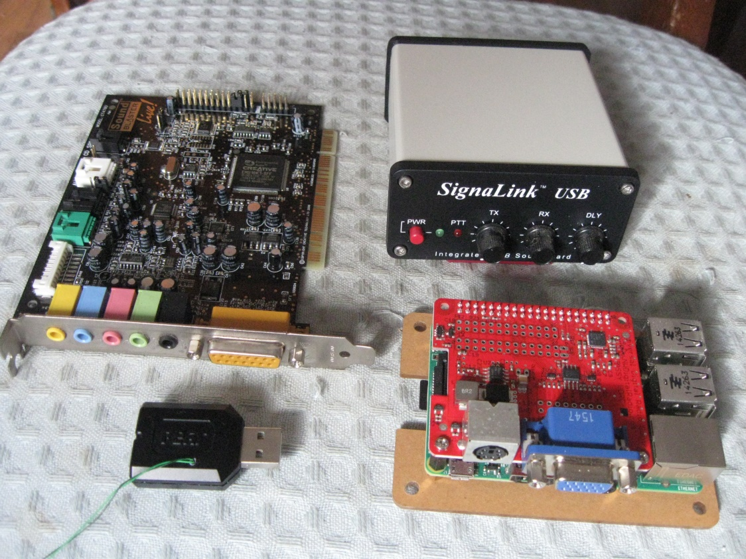
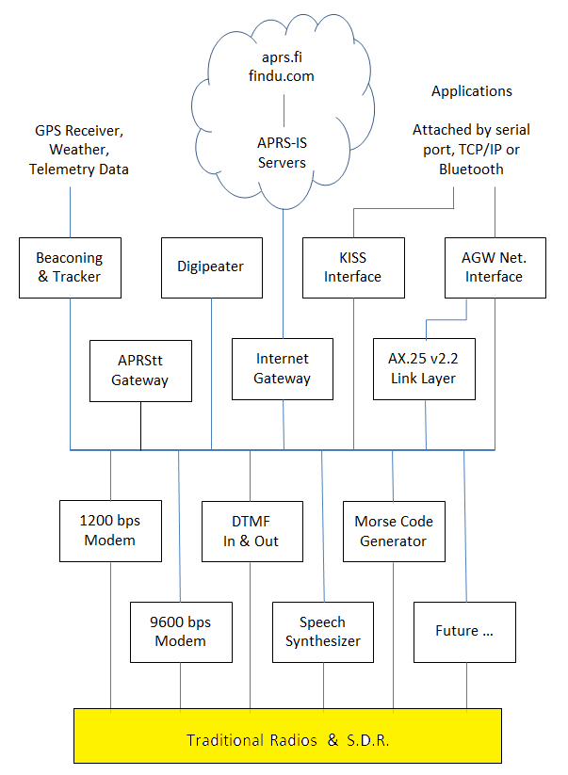
Traditional Radio Interface
Receiver audio → computer.
Computer audio → transmitter.
Notes:
Starting at the bottom of the block diagram, this is what connects to your radio.
The interface to the radio is just audio in, audio out, and some sort of PTT control. This is exactly the same that you would use for modes like PSK-31 or FT-8.
All of these devices look much different but they all do the same thing.
The early computers did not have audio built into the motherboard so you needed a separate “sound card” as shown in the upper left.
Below that is a USB audio adapter that runs in the 5 to 10 dollar range. It has audio output for headphones and audio input for a microphone. If you look closely you will see a couple wires sticking out. The C-Media chips have extra general purpose digital I/O pins available. These are sometimes used for pushbuttons or LED indicators. We can use one of the pins for our push-to-talk control.
This is a very tidy solution because it can all be done with a single USB port. There are at least 4 different products available that use this approach and many homebrew plans.
The SignaLink USB is an overgrown version of the USB audio adapter. It also has audio isolation transformers and a relay to break up the ground between the radio and computer. It also a VOX circuit that turns on the transmitter when transmit audio is present.
Finally, in the lower right we have a Raspberry Pi with the UDRC audio board on top.
The round 6 pin connector matches the “data” connector found on many transceivers to make cabling easy.
=============================
Don’t read out loud:
Why the block diagram on the right? My thinking was that it shows where we have zoomed in on the larger picture. Is this helpful or distracting?

Slide 19
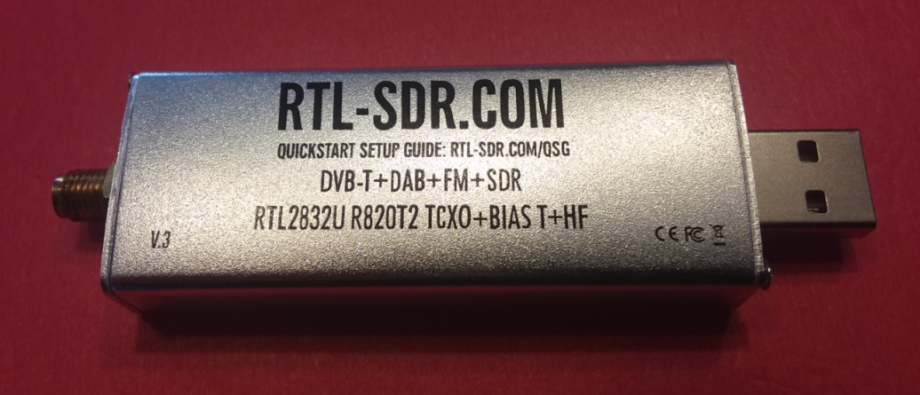
Software Defined Radio (SDR) Interface
Pipe into stdin
rtl_fm -f 144.39M | direwolf -
Listen for audio on a UDP port.
(e.g. gqrx v2.3 and later)
Virtual audio cable. SDR#.
Notes:
For about $20 you can get a little gadget that receives from 500 kHz up to 1.7 GHz. Just add a computer, and the right software, and you have a very versatile receiver.
Dire Wolf can take audio from various SDR applications in different ways.
A simple FM receiver, with no graphical user interface, called rtl_fm, produces audio thru stdout. In this case we can pipe it in thru stdin represented by the dash at the end of the line.
gqrx has a provision to send digital audio by UDP. Dire Wolf can be configured to listen for audio over a UDP port.
The last time I looked at SDR#, it had no special provision for sending received audio into another application for processing. In this case, we can use a virtual audio cable to route audio from one application into another.

Slide 20
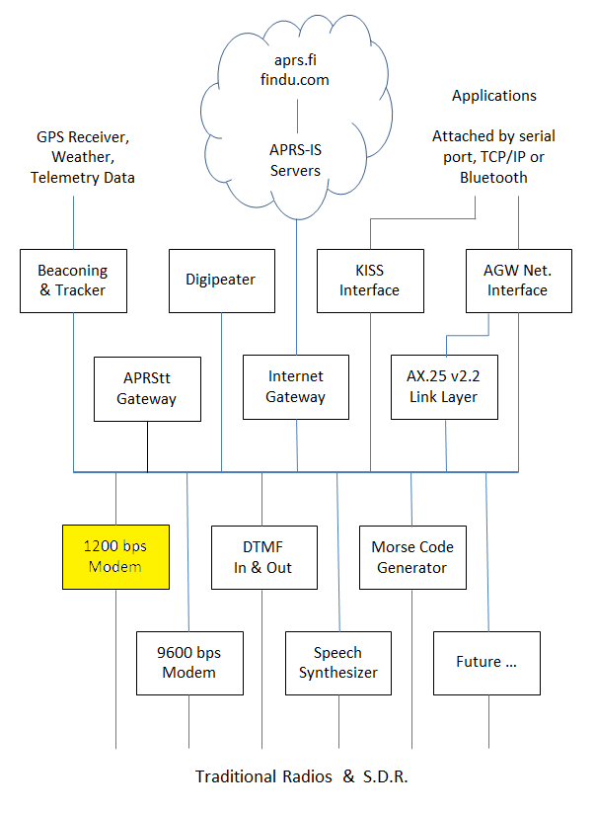
Modems
300 bps AFSK for HF SSB
1200 bps Bell 202 AFSK VHF
2400 bps QPSK (MFJ-2400, etc.)
4800 bps 8PSK
9600 bps G3RUH
Receive only:
AIS – for tracking ships
Emergency Alert System (EAS) Specific Area Message Encoding (SAME)
Notes:
We need modems to send digital data over radios designed for voice communication.
It is interesting to note that the AX.25 protocol standard says absolutely nothing about modems.
According to one of the early Canadian packet radio pioneers, they happened to get a big pile of old Bell 202 modems for 75 cents each. It was a quick and dirty TEMPORARY way to get something up and running quickly and cheaply.
Everyone kept saying it would soon be replaced by something better but here we are, more than 40 years later, and it is still the most commonly used.

Slide 21
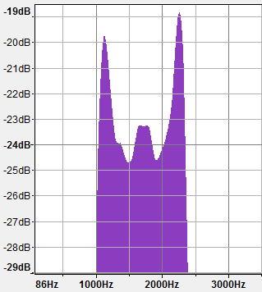
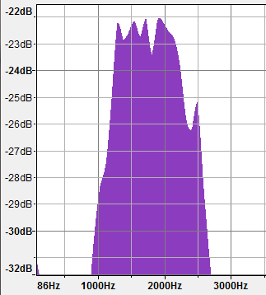
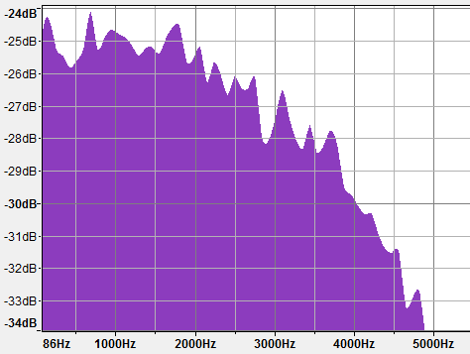
Modem Audio Spectrum
| ← Voice → |
1200 bps AFSK (Bell 202)
2400 bps PSK (V.26 / Bell 201)
MFJ-2400, AEA PK232-2400,
Kantronics KPC-2400
9600 bps (“G3RUH”)
Very low out to about 5 kHz.
Speaker cuts off below about 300 Hz to eliminate CTCSS.
Notes:
We are usually sending data through radios designed for voice communication.
About 300 – 3000 Hz is generally considered voice range so modems need to use audio frequencies in this range.
1200 and 2400 bps modes fit well within this range.
9600 bps is more challenging because it needs frequencies out to around 5 kHz.
Besides the high frequencies, it also needs very low frequencies. VHF FM receivers remove everything below about 300 Hz so you don’t hear the CTCSS tones.

Slide 22
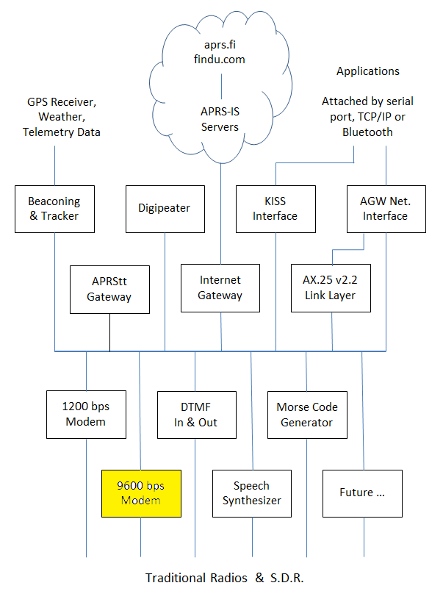
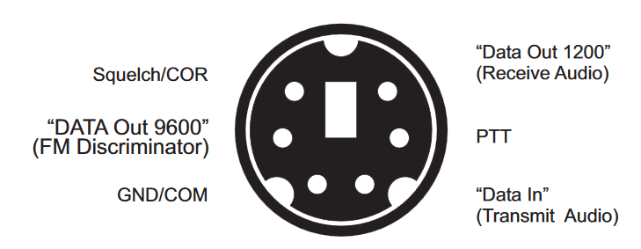
9600 bps
K9NG G3RUH et al – around 1988
About 5 kHz of audio bandwidth.
Will not work with microphone and speaker connections.
Notes:
In the late 1980s there were several different designs to send 9600 bits per second.
I wouldn’t call them “modems” because they just shoved the digital signal into the transmitter resulting in Frequency Shift Keying of the RF signal.
The important thing to remember is that this will not work with the microphone and speaker connectors because the audio passband is too narrow and not flat.
It is necessary to bypass the audio filtering to get wider flatter audio passband. The older literature referred to making a connection directly to the discriminator. In more recent times, there is often a connector available for external modems.
The big 3 Japanese ham radio manufacturers (Kenwood, Icom, Yaesu) standardized on the same 6 pin mini DIN connector. Alinco has the same functionality but a different connector.
The 9600 pin comes right from the discriminator without de-emphasis. This has enough bandwidth for 9600 baud data.
The “data in” pin bypasses the normal microphone audio filtering and goes right into the modulator.

Slide 23

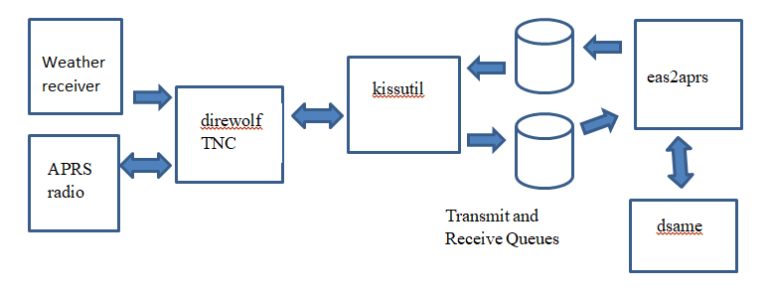
Emergency Alert System
National Weather Service - more than 1000 stations - around 162 MHz.
Encoded:
ZCZC-WXR-RWT-020103-020209-020091-020121-029047-029165-029095-029037+0030-1051700-KEAX/NWS
Translated:
The National Weather Service in Kansas City/Pleasant Hill, MO has issued a
Required Weekly Test valid until 01:30 PM for the following counties in
Kansas: Johnson, Leavenworth, Miami, Wyandotte, and for the following counties
in Missouri: Cass, Clay, Jackson, Platte. (KEAX/NWS)
Notes:
Here is another interesting feature most of you probably did not notice.
(Listen to the sample audio…. Click on the speaker icon)
The National Weather Service operates over a thousand VHF FM weather stations around 162 MHz.
During an emergency they transmit a digitally encoded signal that that can sound an alarm.
You also hear the same thing on TV occasionally, “This is test of the Emergency Broadcast System …”
Dire Wolf can receive these signals. A sample script is provided to change the encoded form to plain text and transmit APRS bulletins.

Slide 24
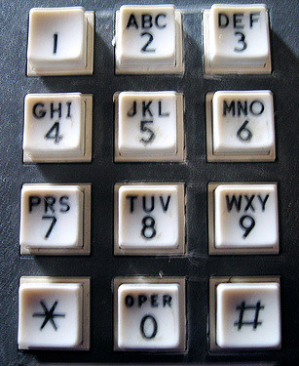
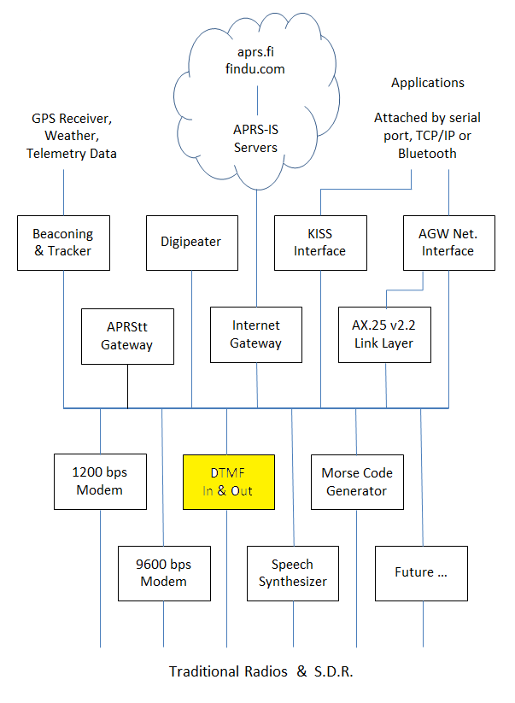
DTMF decode / encode
Received tone sequences are converted to packet like:
DTMF>APDW15:t12345#
Transmit tones by putting DTMF in the destination address.
WB2OSZ>DTMF:123 456
Notes:
Dire Wolf also has the ability to encode and decode DTMF, commonly known as “Touch Tones.”
Internally they are stored in the same format as AX.25 packets so applications can send and receive touch tone sequences.
Optional more details:
In the receive direction, tone sequences terminated by the # key are converted to the same internal format as normal packets. They are identified by DTMF in the source field and information part beginning with lower case t.
In the transmit direction, a destination field of “DTMF” means that touch tones should be sent instead of the normal AX.25 frame.
Otherwise these are handled like any other packets. Upper level applications can send and receive them.

Slide 25

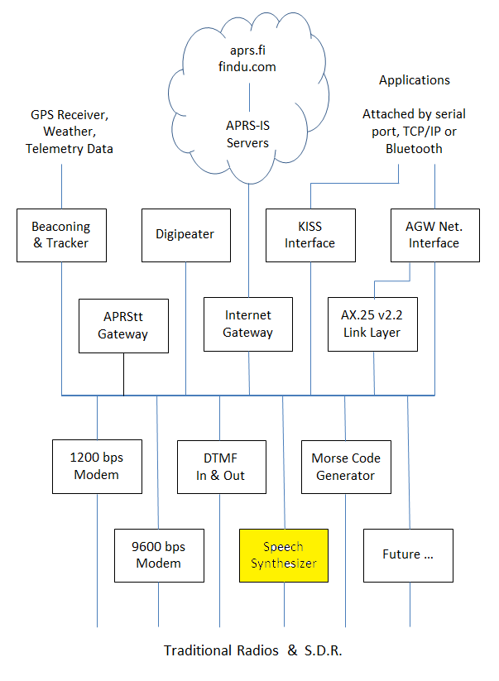
Speech Synthesizer
Any packet with SPEECH is sent to a user-supplied script which can invoke a text-to-speech synthesizer.
WB2OSZ>SPEECH:Hello, World!
Configuration file example:
CBEACON dest=SPEECH info=”Club meeting tonight at 7 pm.”
Notes:
Dozens of free speech synthesizers are available. Just feed in text and out comes spoken words.
When the destination address contains “SPEECH” the information is not sent as a normal packet.
Instead, a user-defined script is invoked. This can pass the text along to the speech synthesizer of choice.

Slide 26
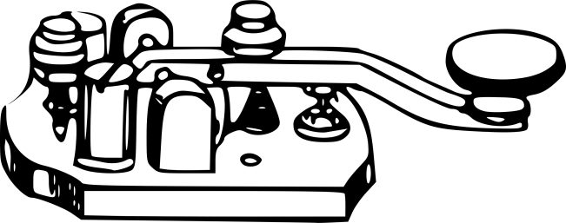
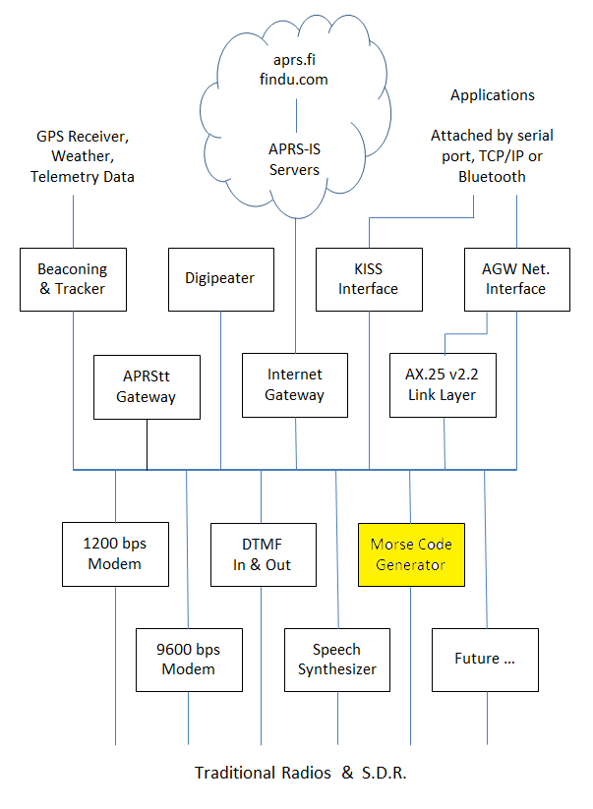
Send Morse Code
Any packet with MORSE as the destination is sent as Morse Code.
WB2OSZ>MORSE:CQ CQ
Notes:
Similarly, if the destination address is “MORSE” the information part is sent as Morse Code.

Slide 27

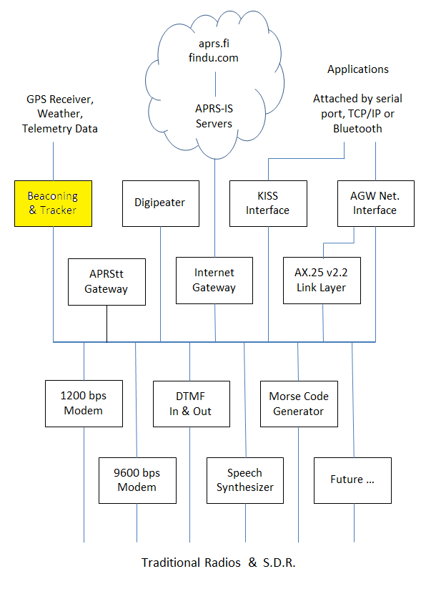
Beacons
Periodic position or object packets.
GPS location - tracker.
“Custom” - invoke user script.
Weather. wxnow.txt
Notes:
Above the center we have different producers and consumers of packets.
Beacons are automatic periodic transmissions usually containing a location and an icon for something like a house or a car.
When the location comes from a GPS receiver, we have a tracker.
Custom Beacons can have user defined content This could be used for weather information or anything else you want to put there.

Slide 28
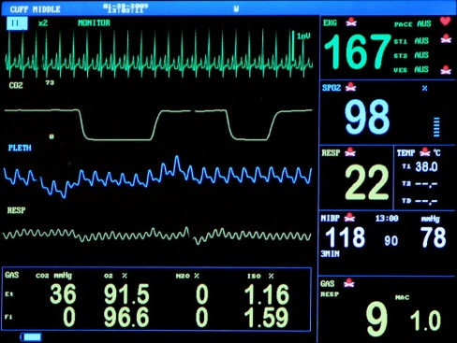
Telemetry Tool Kit
Building blocks for your own customized solutions.
User-defined script to generate content.
Raspberry Pi A/D converter example.
Notes:
Dire Wolf includes a collection of scripts and examples that can be used as building blocks for constructing your own customized telemetry.
It includes a complete example of connecting an A/D converter to a Raspberry Pi and transmitting the measured voltage as APRS Telemetry.

Slide 29
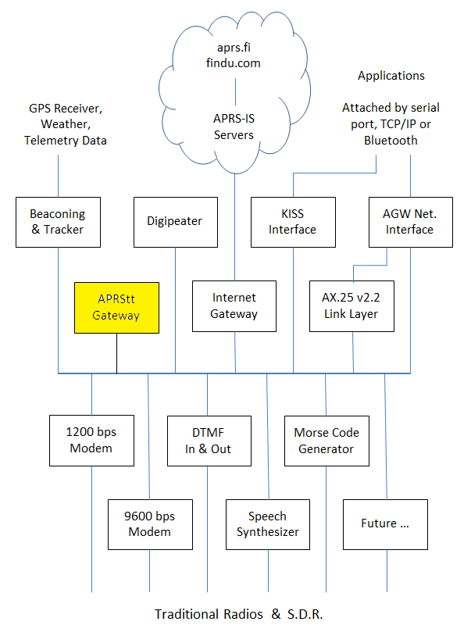
APRStt Gateway
Converts Touch Tone sequences into APRS objects.
Notes:
Very few hams have portable equipment for APRS but nearly everyone has a handheld radio that can send DTMF tones.
APRStt allows a user, equipped with only DTMF (commonly known as Touch Tone) generation capability, to enter information into the global APRS data network.
This has been around since the turn of the century but never became real popular.
Earlier implementations required specialized hardware and were not easily adaptable to new situations.

Slide 30
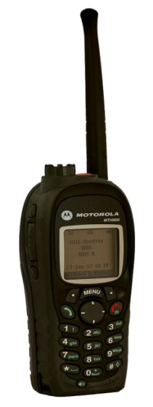




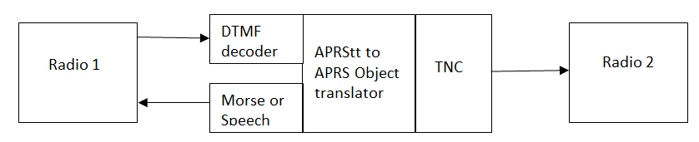
Tones 3 1 2 #
APRS
Object Report
Synthesized Speech
“Canoe 12 is at checkpoint 3.”
APRStt Gateway
Notes:
Here is an example of how APRStt could be useful.
Suppose the organizers of a canoe race wanted to keep track of the locations of the participants but didn’t have a budget to put a GPS APRS tracker on each canoe.
Instead they have observers at various points along the way.
The APRStt gateway is configured to recognize sequences of 3 digits. The first digit is a predefined location. The other two digits are a canoe number.
The observer, at checkpoint 3, would send the touch tones 3 1 2 # to report that canoe 12 is passing by.
The gateway would confirm receipt of the report by responding with synthesized speech.
It would also send an APRS Object Report. This could be displayed on a real time tracking map.

Slide 31
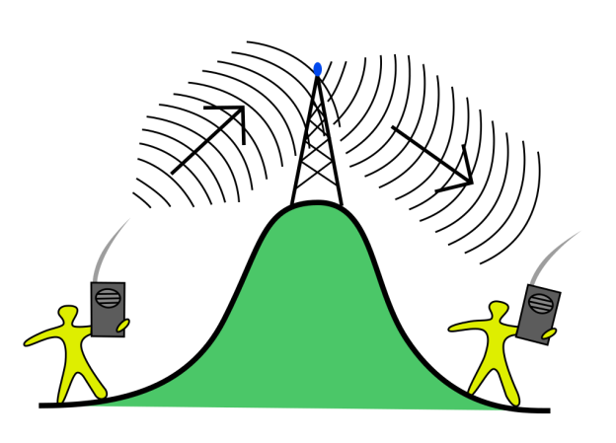
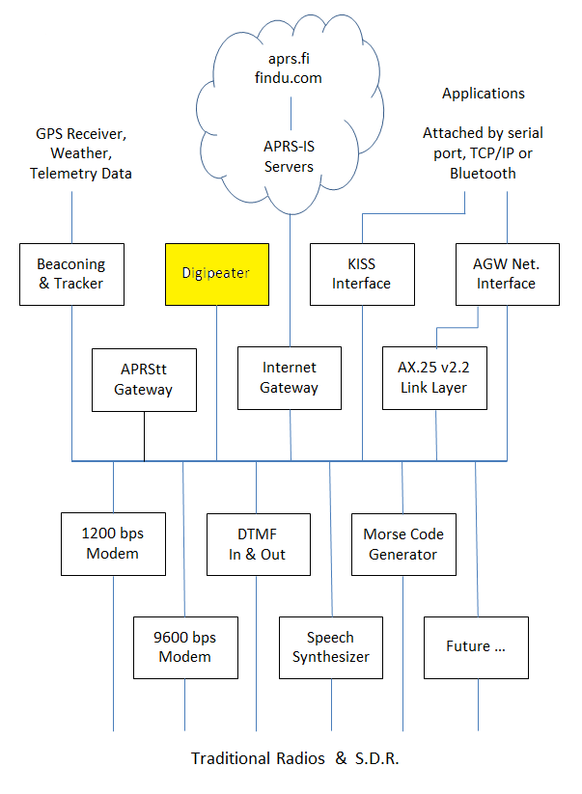
Digital Repeater “digipeater”
Extends range.
Usually single frequency.
Store and Forward.
Dire Wolf: Multiple radios & routing between radio channels with filtering.
Notes:
A digital repeater serves the same purpose as a voice repeater. It extends the range of a radio signal by retransmitting it from a different location.
A voice repeater receives on one frequency and simultaneously retransmits on a different frequency.
A digital repeater generally operates on a single frequency. A packet is stored in memory and then retransmitted when the channel is clear.
There is a provision for the maximum number of repeater hops. This is decremented each time so a packet does not go bouncing back and forth forever.
The Dire Wolf implementation is unique in that it can connect to several radios and configured with rules controlling what gets forwarded between radio channels.

Slide 32

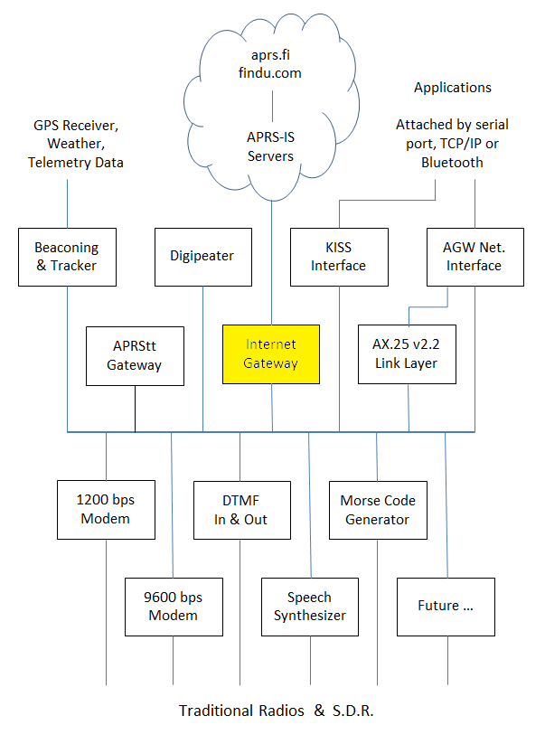
Internet Gateway “IGate”
Connect disjoint radio networks.
Should be two way.
View APRS activity with web browser at
aprs.fi
findu.com
aprsdirect.com
Notes:
Some people think that IGate stations exist so you can view worldwide APRS activity with a web browser but they are missing the big picture.
The purpose of Internet Gateway, or IGate, stations is to enable flow of information between disjoint local radio networks.
It is meant to be a two way system and receive only IGate stations break the system.

Slide 33
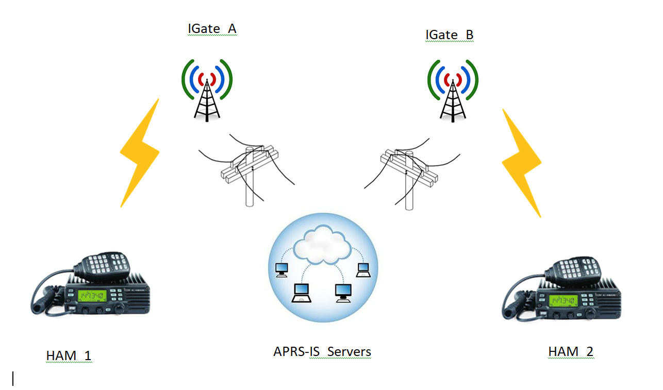
APRS “Messages”
Two way IGate stations required.
Notes:
This illustrates how IGate stations can be used to send an APRS message to someone on the other side of the world.
Ham 1 sends an APRS message addressed to Ham 2.
The gateway station A passes the message along to the global network of servers.
The servers check their database for recent activity of Ham 2 and which IGate stations reported that information.
The servers forward the message to those IGate stations.
When Ham 2 receives the message, an automatic acknowledgement goes back to the sender in a similar way.
The messaging application, used by Ham 1, reports that the message was received. If there is no response for a while, multiple retries are made until it gives up and reports failure.
Some people set up receive only IGate stations which go from RF to the Internet but not the other way. This breaks the messaging system because there might not be another nearby return path for a reply.
IGate stations should be configured for two way communication. There might be legal restrictions in some countries but not here.

Slide 34
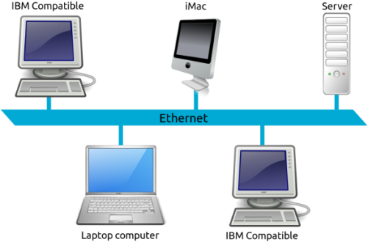
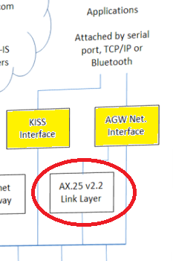

Application Interfaces
KISS and AGW network interfaces.
AGW interface allows access to more brains in the TNC such as connected mode.
Applications attached by:
RS-232 Serial Port.
TCP/IP ( Ethernet, WIFI )
Bluetooth.
Many simultaneous applications.
Notes:
Besides operating standalone, Dire Wolf can also be used as a virtual TNC by applications that were written for use with the old TNCs.
We are no longer restricted to an RS-232 signal cable. We can now use TCP/IP over WiFi and Ethernet. Many applications can access the virtual TNC at the same time.
KISS, the “temporary” stop gap measure from 30 years ago is still going strong.
There is also a newer “AGW” protocol (from AGWPE) which allows applications to access more intelligence in the TNC.
For connected mode, the TNC provides reliable transport. Sequence numbers are added to information frames. Acknowledgements and automatic retries will get the information there or provide an error indication that it failed.

Slide 35
Building a Better Demodulator
Notes:
I have no academic or professional background in digital signal processing so I had no clue on how to go about building a modem in software.
It involved a lot of reading and experimenting and relentless tweaking until it worked better.

Slide 36
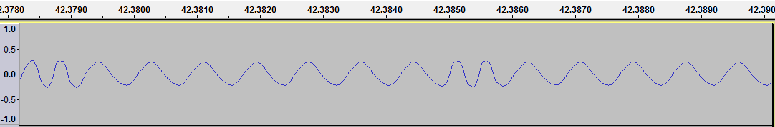
Audio Frequency Shift Keying
1200 bits per second, 1200 & 2200 Hz.
Which of the two tones is present?
Notes:
The AX.25 protocol standard says absolutely nothing about the modem to be used.
As mentioned earlier, the early experimenters used the Bell 202 standard because they happened to acquire a pile of modems for 75 cents each. They used those to get started until something better could be developed.
Here we are, more than 40 years later still using the same thing.
Data is sent at 1200 bits per second using two different audio frequencies: 1200 & 2200 Hz, often called “mark” and “space,” to represent the logic 1 and 0 values. This is called audio frequency shift keying (AFSK).
A demodulator needs to listen for those two tones and decide which one is present.

Slide 37
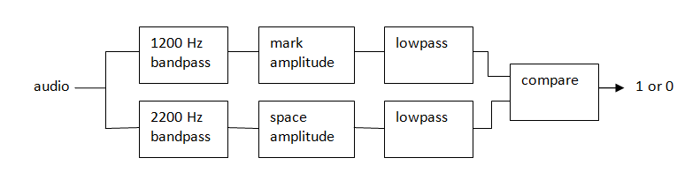
How to Demodulate AFSK
Notes:
This is one way we can implement a demodulator for AFSK. We start off with a bandpass filter for each of two the audio frequencies. In the old days, you might use an inductor and capacitor. Later we progressed to active filters with op amps. Single chip modems became available. Today it can be done better and cheaper in software.
We take the amplitude of each tone and use a low pass filter which passes the demodulated data while removing the audio carrier.
Finally, we have a comparator to decide which tone is stronger and the result is logic 1 or 0.
This goes to an HLDC decoder that looks for patterns in the bit stream and spits out groups called “frames.”

Slide 38
After much reading & experimenting
OK with perfect signals.
Not so good with real-world signals.
Why?
Notes:
I was thrilled when I was able to decode ideal signals.
It soon turned into disappointment when I tried it on real world signals and it did not work very well comparted to a TNC from the previous Century.
Why? How were the real world signals different than the ideal signals?

Slide 39
WA8LMF TNC Test CD
Los Angeles, afternoon rush hour, frequency completely saturated.
Track 1: 25 minutes of flat audio from the discriminator.
Track 2: De-emphasis to mimic typical receiver. (explained later)
The de facto standard for measuring demodulator performance.
More details, see: A-Closer-Look-at-the-WA8LMF-TNC-Test-CD.pdf
Notes:
WA8LMF has provided the ham community with a wonderful resource for evaluating the performance of TNCs with real world signals.
He drove around Los Angeles, during rush hour gathering a wide variety of APRS signals. It is a wonderful collection: Under deviation, over deviation, people stomping on each other, even some really strange looking signals that make you wonder where they came from.
This is an important point. Track 1 has the wide flat audio taken from the discriminator before any de-emphasis.
Track 2 has low pass filtering to produce a signal more like what would typically come out of the speaker.
This has become the de facto standard for measuring TNC decode performance.

Slide 40
TNC Test CD Results
Do not take too seriously. Collected by different people, at different times, under different conditions. Most don’t specify Track 1 / Track 2.
Linux PC multimon * 130
Linux PC soundmodem * 412
AGWPE * 500
AEA PK90 728
TNC-X 818
MFJ-1274 883
AX25 Java Soundcard Modem * 964
KPC-3 (non-plus) 967, 986
SCS Tracker DSP TNC 1.5s 988 / 943 (track 1/2)
Dire Wolf 1.7 * 1014 / 1000 (track 1/2)
UZ7HO Soundmodem 0.83b * 1021
* = software on PC
Notes:
Many people have reported number of frames decoded from the TNC Test CD.
I have gathered many of the reports together here.
Remember that these numbers were gathered by different people, different times, under different conditions, so don’t take them too seriously.
[[ Original sources are cited in one of the Dire Wolf documents. ]]
The software modems are in yellow. They include the worst and the best.
If we make a little graph, an interesting pattern becomes clearer.

Slide 41
TNC Decoding Comparison
Poor results from early software modems.
Bad reputation.
More recent software better than hardware modems.
The tarnished reputation endures.
Notes:
The traditional TNCs with modem chips did pretty well.
The early “soundcard modem” software produce poor results, giving this approach a bad reputation.
You will find outdated articles claiming that you need to buy special hardware for acceptable results. Was true at one time but not anymore.
Today, a couple of the software implementations out perform the modem chips.

Slide 42
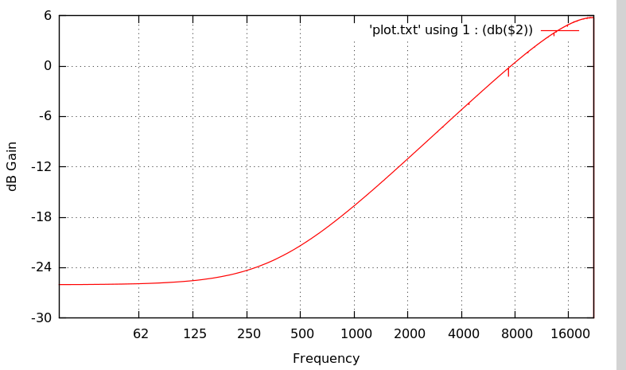
VHF FM voice transceivers.
Transmitter pre-emphasis
+ 6 dB per octave.
Receiver de-emphasis
- 6 dB per octave
Notes:
This is a big part of our problem.
When using modems, we would like the audio going into the transmitter to come out of the receiver with a minimum of distortion.
VHF FM transceivers are designed for voice and do bad things to signals from modems.
On transmit, we have pre-emphasis. This means the higher audio frequencies are increased in amplitude.
On receive, the opposite happens. De-emphasis uses a low pass filter to decrease the amplitude of higher frequencies.
In an ideal world, they would cancel out but we often end up with an audio passband which is not flat.
It might OK for voice but bad for digital data. The distortion makes it more difficult for modems to demodulate signals properly.
As we saw earlier, some transceivers have special sockets to bypass the audio filtering when using external modems.

Slide 43
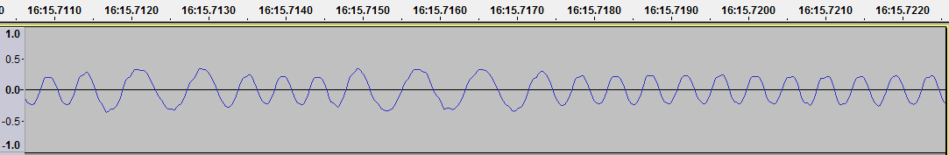
Transmit / Receive mismatch
Flat on transmit.
Higher frequency weaker.
Notes:
The situation is worse when we have a mismatch between the transmitter and receiver.
If you have flat audio from the transmitter and a low pass filter on the receiver, you end up with a situation like this.
This is an actual signal captured on the air. The higher audio tone is considerably weaker than the lower frequency.

Slide 44
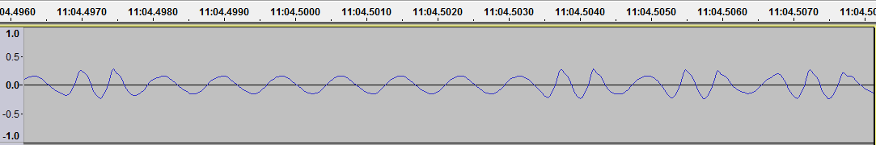
Transmit / Receive mismatch
Higher frequency is stronger .
Flat on receive.
Notes:
This is the opposite situation.
The transmitter has pre-emphasis and boosts the higher audio frequency.
On the receiving end there is no de-emphasis. As a result, the higher audio tone is stronger.

Slide 45
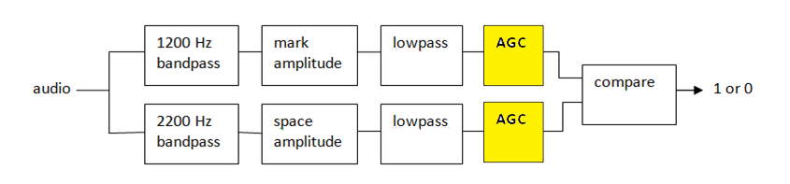
Transmit / Receive mismatch
Less reliable.
Automatic gain control?
Better but… AGC time … noise
Notes:
With either mismatch case, the demodulator has a difficult time rapidly deciding which tone is stronger and it is less reliable.
My first attempt at improvement was to add automatic gain control so both would get normalized to the same range.
Results were better but AGC takes time to adjust and can get thrown off by bursts of noise.

Slide 46
Multiple demodulators.
Notes:
A brute force approach would be to use multiple demodulators in parallel.
Different filters in front of them would compensate for the various cases of the two tones being out of balance.
Duplicates, arriving at nearly the same time, would be removed.
The demodulator is compute intensive using hundreds of multiplies and adds for every audio sample. Running three, like this, would triple the CPU power demand.

Slide 47

Multiple Gains for One Tone.
Multiple fixed gains.
Less compute power needed.
Notes:
I used a variation on the theme where the computationally intensive part is done only once. After obtaining amplitudes for the two tones, one of the amplitudes is increased or decreased before comparing to the other.
This works well and doesn’t take as much processing power as the brute force method.
All of the top performing software TNCs use some variation on this theme. They all have multiple demodulators running in parallel to compensate for twist in the received signal.

Slide 48
AX.25 + FEC = FX.25
2006 – Stensat Group – Satellites
64 bit pattern to identify the format of the data to follow.
The normal AX.25 frame, including the FCS, and surrounding “flag” patterns.
Parity check bytes.
8 bytes | 32 To 239 bytes | 16, 32, or 64 bytes
Correlation Tag | Data (Normal AX.25 Frame) | Parity Check
Notes:
What can you do if your radio signal isn’t quite strong enough to get through reliably? More power? Move to higher ground? Get a better antenna?
Sometimes those are not options. Another way to improve communication reliability is to add redundant information so the message will still get through even if small parts are missing.
Adding additional information, so the receiving end can fix up errors, is known as Forward Error Correction (FEC). This is very common. It is used in all sorts of radio communication, digital video, QR codes, DSL, and disk drives. It is even used with CDs and DVDs to work around errors caused by scratches.
Back on 2006, the Stensat Group came up with a clever way to add Forward Error Correction to AX.25 while maintaining complete backward compatibility with existing equipment. Each frame is now transmitted with:
- A carefully chosen 64 bit pattern to identify the format of the data to follow.
- The normal AX.25 frame, including the FCS, and surrounding “flag” patterns.
- Parity check bytes.
An ordinary TNC just sees the normal AX.25 frame in the middle. The correlation tag and check bytes look like noise and are ignored.
Their application was for satellites and the receiving implementations were oriented towards satellites. I thought it would be interesting to integrate this into a general purpose TNC so it would be easy to use in other situations.

Slide 49
AX.25 + FEC = FX.25
Tag Number | Correlation Tag Value | Data Bytes | Check Bytes | Number of Defective Bytes that can be repaired.
0x01 | 0xB74DB7DF8A532F3E | 239 | 16 | 8
0x02 | 0x26FF60A600CC8FDE | 128 | 16 | 8
0x03 | 0xC7DC0508F3D9B09E | 64 | 16 | 8
0x04 | 0x8F056EB4369660EE | 32 | 16 | 8
0x05 | 0x6E260B1AC5835FAE | 223 | 32 | 16
0x06 | 0xFF94DC634F1CFF4E | 128 | 32 | 16
0x07 | 0x1EB7B9CDBC09C00E | 64 | 32 | 16
0x08 | 0xDBF869BD2DBB1776 | 32 | 32 | 16
0x09 | 0x3ADB0C13DEAE2836 | 191 | 64 | 32
0x0A | 0xAB69DB6A543188D6 | 128 | 64 | 32
0x0B | 0x4A4ABEC4A724B796 | 64 | 64 | 32
Notes:
The correlation tag identifies the number of data and check bytes following.
The Reed-Solomon algorithm is used to attempt fixing errors. The number of bytes that can be repaired is one half the number of check bytes.
The sender can choose an appropriate correlation tag depending on amount of space required for the AX.25 frame and the desired strength of error correction.
FX.25 has been used for some Amateur Radio Satellites but never gained any acceptance outside of that little niche. Now that FX.25 has been integrated into a general purpose TNC, there are many new possibilities for using it.

Slide 50
FX.25 Improvement for APRS
Notes:
I did an experiment to evaluated how well it worked.
1000 APRS packets are sent with regular AX.25 and FX.25.
A controlled Bit Error Rate is introduced at the receiving and the number of frames received correctly is counted.
Regular AX.25 fails when even a single bit is corrupted.
FX.25 can fix up to 32 bytes (that’s bytes, not bits!!!) in a corrupted frame.
FX.25 keeps going strong long after regular AX.25 is completely useless.

Slide 51
FX.25 Improvement for traditional Packet Radio
Notes:
Connected mode is used for a point to point link between two specific stations. The receiving end acknowledges what has been received and asks for repeats of missing pieces. After the maximum retry count is exceeded, it gives up.
Connected mode AX.25 packet radio is often used, with applications like Outpost PM and WinLink Express, for emergency communications.
This test uses 100 frames each with 128 information bytes.
The throughput rate is the total number of bytes divided by the time required. As the error rate increases, more retries are required, and the throughput decreases. At some point, it just gives up before reaching the end. We give this a score of 0.
Under good conditions, FX.25 is slower because it has more overhead. When conditions deteriorate, FX.25 shows little or no degradation long after AX.25 is completely useless.

Slide 52
Summary
Ignore the advice from around the turn of the Century
You don’t need to spend $200 on a box from the 1980’s to get started with APRS / Packet Radio.
Free Open Source Software:
Better Performance
More Features
Lower Cost
Notes:
There is no shortage of packet radio / APRS tutorials. Most of them are from 15 or 20 years ago or even the previous Century.
They will tell you need to spend a substantial amount of money on special hardware, just to get started, and only list software which has been obsolete for a long time.
If software TNCs are mentioned at all, they are dismissed as having poor performance.
There are times when it is beneficial to have specialized hardware but you don’t need to spend anything to get started. After gaining some experience you can make better informed purchasing decisions.
Nowadays the newer software TNCs have left the 1980s style hardware behind in the dust. They have better performance, more features, and lower cost.

Slide 53
Questions?
For more information:
https://github.com/wb2osz/direwolf
https://groups.io/g/direwolf
wb2osz @ arrl . net
APRS is a registered trademark of APRS Software and Bob Bruninga, WB4APR. http://www.aprs.net
Linux is a registered trademark owned by Linus Torvalds.

